Slide 1
Complete SEO audit
For we love paving

Slide 2
Technical SEO

Slide 3
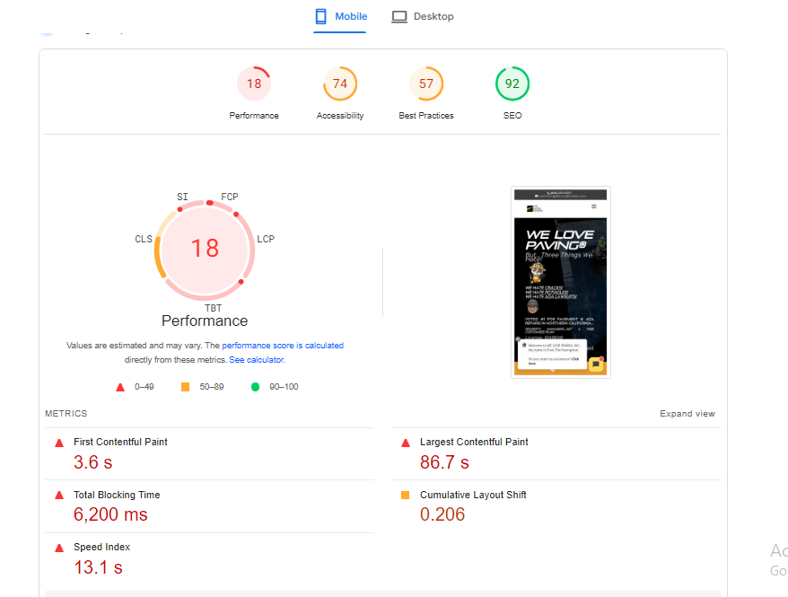
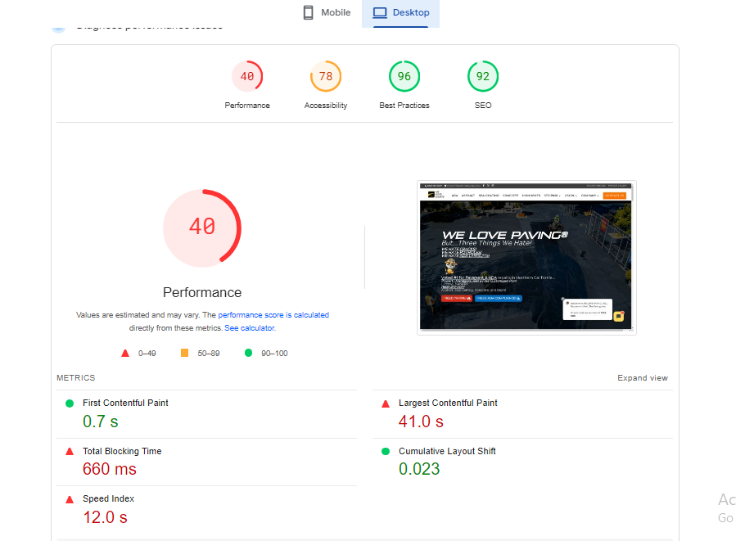
Website performance Speed
It's crucial to optimize the website speed for both mobile and desktop platforms as the current performance is suboptimal. Ideally, aiming for a score of 85% or higher for both platforms is considered desirable for better user engagement and overall website performance.

Slide 4
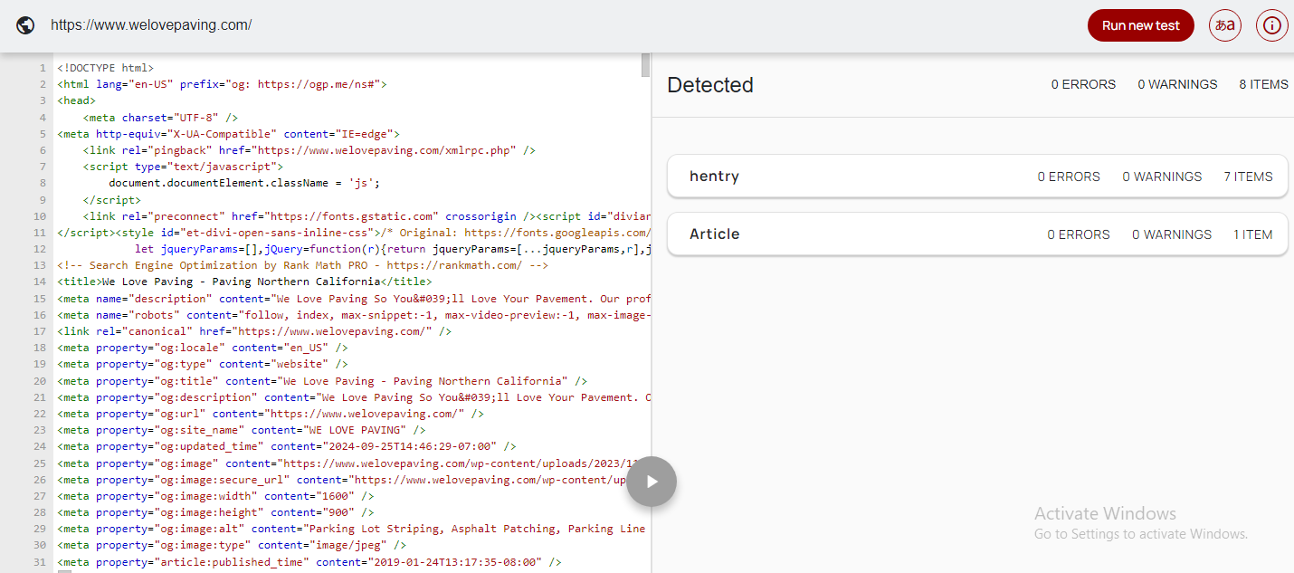
Schema Validation

Slide 5
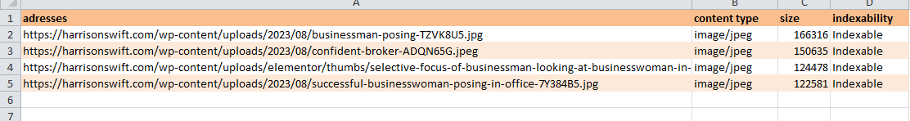
Images Over 100 kb
During the website review, it was found that 4 images exceed the recommended 100kb limit, which can significantly slow down the site's loading speed. To enhance speed and improve user experience, it's advisable to compress these images without compromising quality. This optimization measure will contribute to faster page loading times and smoother navigation for visitors.

Slide 6
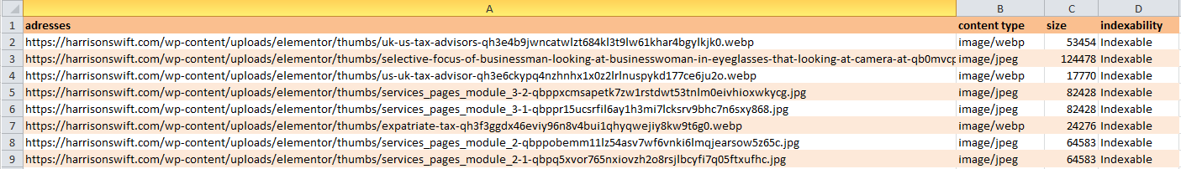
Images missing Size Attributes
8 Images were found without defining size attributes. Image elements without dimensions (width and height size attributes) specified in the HTML.
This can cause large layout shifts as the page loads and be frustrating experience for users. It is one of the major reasons that contributes to a high Cumulative Layout Shift (CLS).

Slide 7
On – Page Audit

Slide 8
Page Title Over 60 Characters
During the website audit, I identified 1 page with meta title that exceed the predefined length of 60 characters. These lengthy meta titles can negatively impact SEO and user experience, as search engines may truncate them in search results. To optimize these titles, it's recommended to revise them to fit within the specified character limit

Slide 9
Page Title below 30 Char
During the website audit, it was observed that 2 pages have meta titles below the predefined length of 45-60 characters. Meta titles that are too short may not adequately convey the page's content to search engines and users, which can impact SEO performance. It is recommended to optimize these page titles by expanding them to the predefined length

Slide 10
Meta Description Over 155 Characters
During the website audit, it was found that 2 pages have meta descriptions over the predefined length of 145-160 characters. Meta descriptions provide a concise summary of the page's content and play a crucial role in attracting users from search engine results pages (SERPs)

Slide 11
Missing Meta Description
During the examination of your website, it was identified that 01 page is missing meta description, which could negatively impact your website's search engine performance. To address this issue, I strongly recommend adding unique, SEO-optimized meta descriptions to each page. This will significantly improve your website's visibility and enhance the overall user experience.

Slide 12
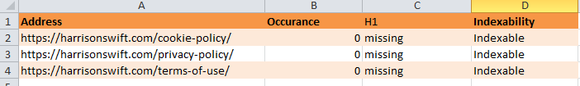
Missing H1
It was identified during the website audit that approximately 3 pages are missing H1 tags. To enhance visibility and improve user understanding, it is recommended to add unique and descriptive H1 tags to each page. H1 tags help search engines understand the content of individual pages better, improving their relevance and visibility in search results.

Slide 13
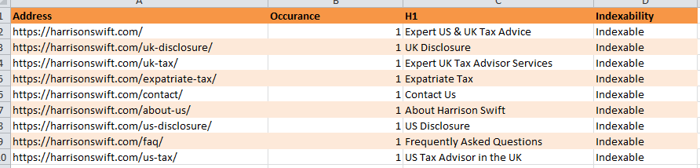
Non Sequential H1 tags
9 pages have an <h1> tag that is not the first heading on the page. To align with SEO best practices and improve accessibility, heading elements should follow a logical, sequential order. The <h1> tag should be the primary heading, followed by <h2> to <h6> in descending order. This logical structure not only helps search engines better understand the content hierarchy but also enhances navigation for users, including those relying on assistive technologies

